Slide 1
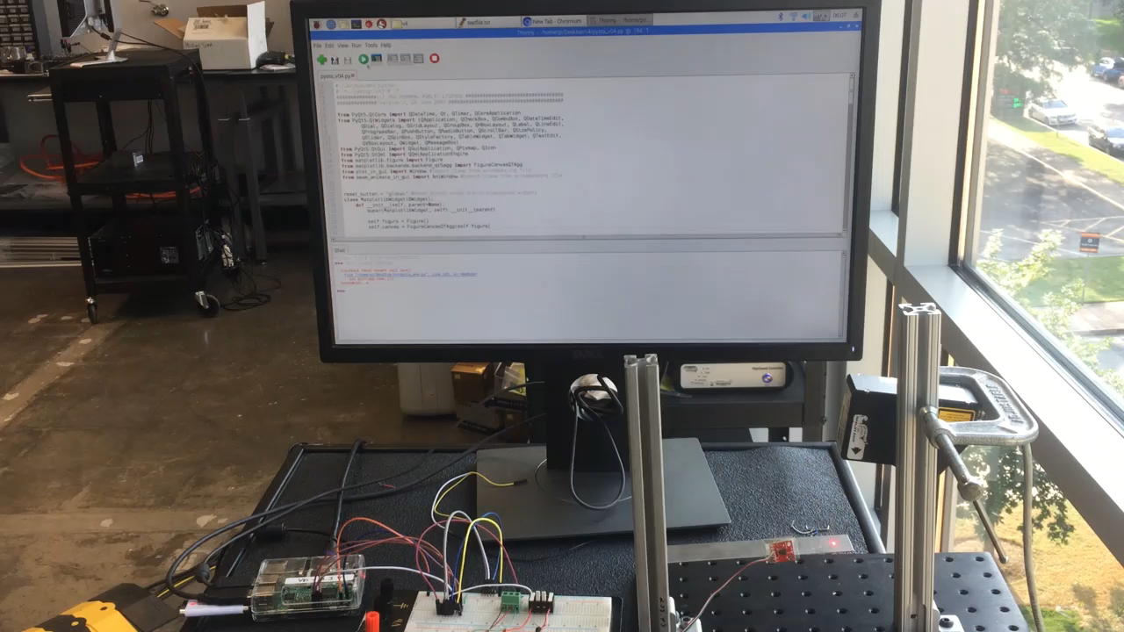
Demonstration – Data plotting

Slide 2
Python Standard Testing Application
PySTA
Marc Eitner, Palash Jain, and Chloe Johnson
ME 369
Dr. Mitchell Pryor

Slide 3
Outline
Overall Objective
Goal of Project
Demonstration
Code Development
Signal Reading
GUI
Animation
Future Work

Slide 4
Overall Objective
Replicate an instrument interface such as LabVIEW using Python and a Raspberry Pi, making data collection for small experiments portable, affordable, and user-friendly.
LabVIEW can be large and expensive
Software: $400 - $5000 /year
Data Acquisition: > $200
PySTA
Python: FREE
Data Acquisition:
Raspberry Pi:
Analog to Digital Converters: $2.50

Slide 5
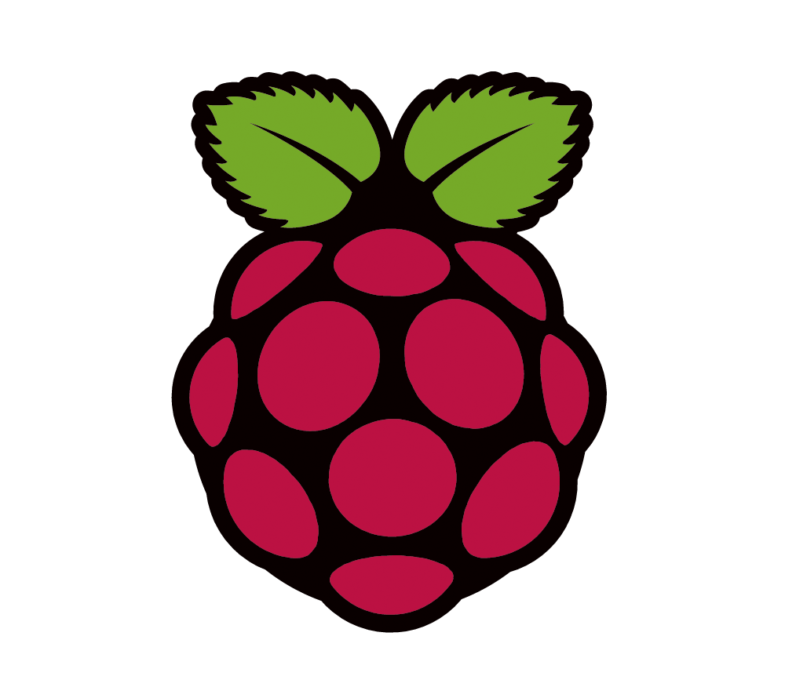
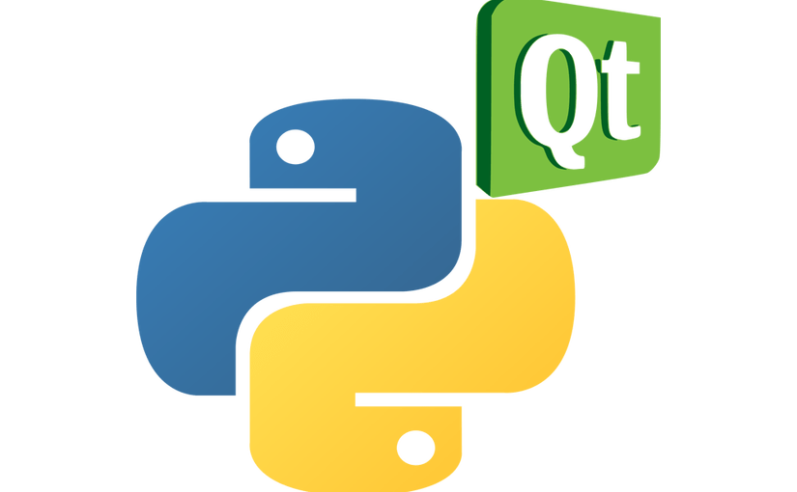
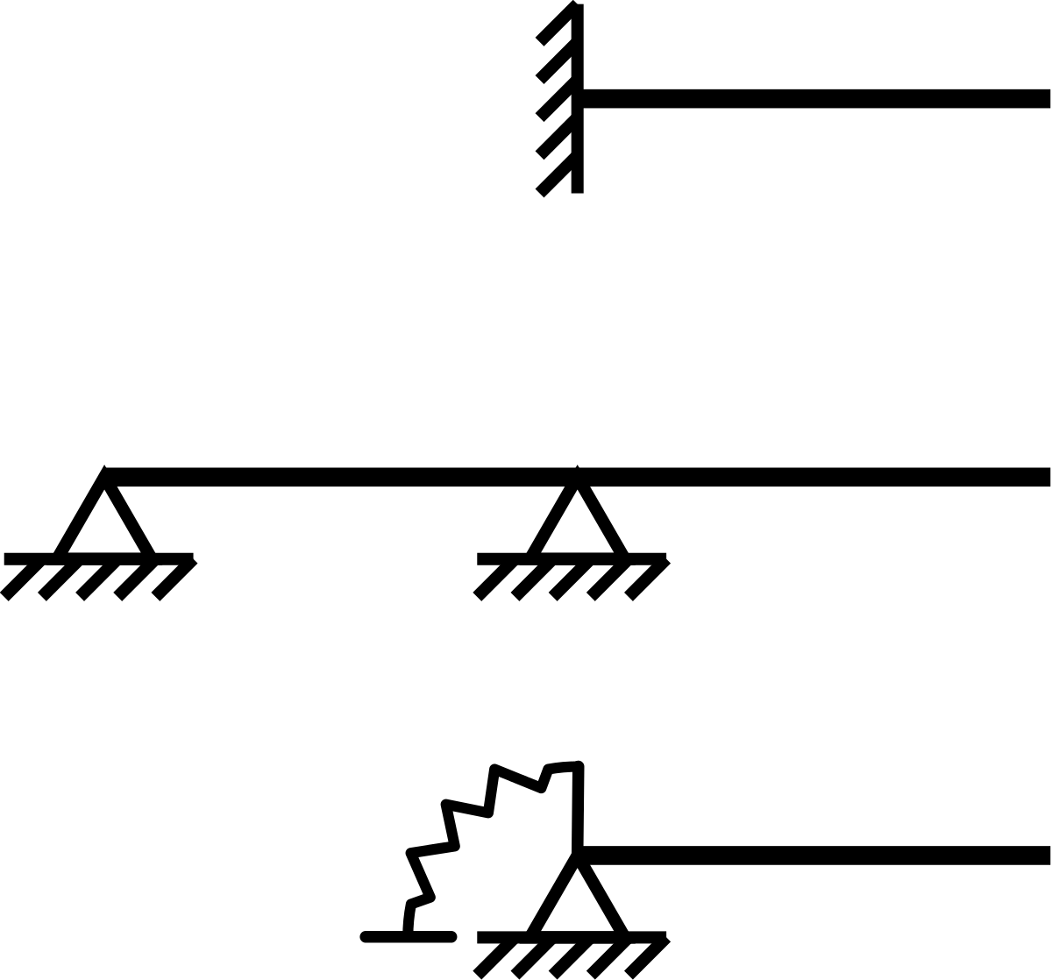
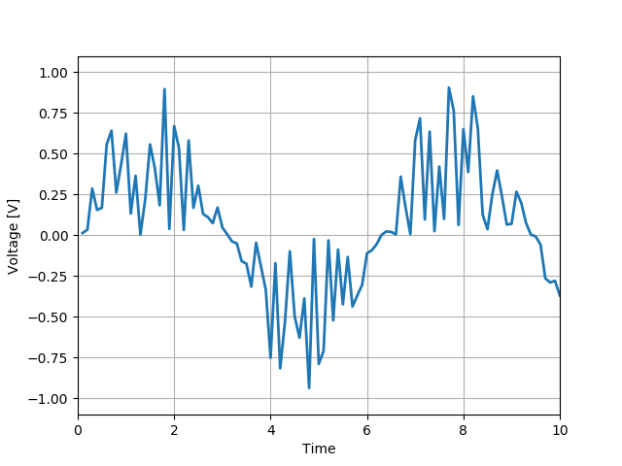
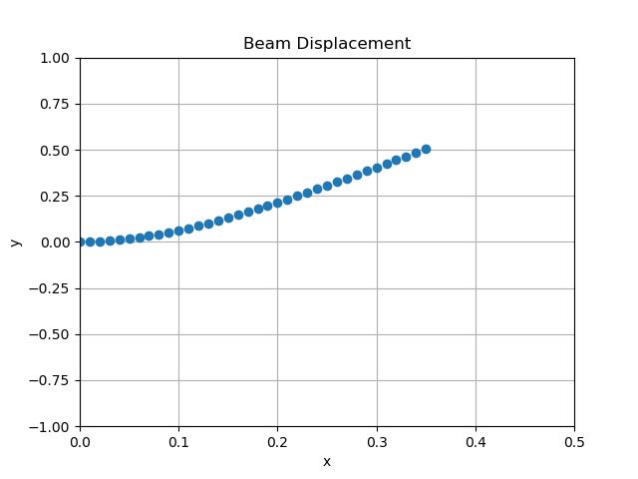

Goal of Project
a(t)
y(t)
Raspberry Pi
GUI in PyQT
Store Data
Live Voltage Outputs
Beam Animation

Slide 6
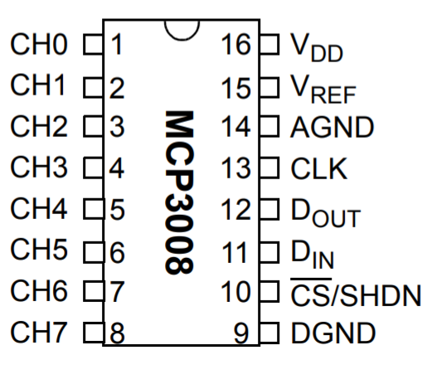
Hardware wiring
Connection of Analog-Digital-Converter
https://cdn-shop.adafruit.com/datasheets/MCP3008.pdf
Analog sensor connection side
Raspberry Pi connection side

Slide 7
Code Development: Signal Reading 1
Main library used: Adafruit_MCP3008 and SPI.SpiDev
Interface between Analog-Digital-Converter (MCP3008) and Raspberry Pi
Create an object:
mcp = Adafruit_MCP3008.MCP3008(spi=SPI.SpiDev(SPI_PORT,SPI_DEVICE))
…and read the data:
for i in range(0,8): # loop over all channels
values[i] = mcp.read_adc(i)*3.3/1024 # read and convert to Volts

Slide 8
Code Development: Signal Reading 2
Class Measurement():
def __init__(self, fs=100):
self.time = []
self.data = []
self.fs = fs
def setData(self, values)
def setTime(self, t0)
def saveData(self, data_type = ‘time_domain’, ‘name = testdata’)
def filterData(self, filter_options) future work

Slide 9
GUI: The PyQt5 Library
Three major actions in PyQt5
Create Widgets
Qlabel()
QLineEdit()
QPushButton()
QCheckBox()
QHBoxLayout()
QVBoxLayout()
QGridLayout()
FigureCanvas()
and many others…
Place Widgets
layout.addWidget (widget)
addLayout(layout)
setLayout(layout)
addTab()
…
Feedback Action
button.clicked.connect (function)
textChanged.connect (function)
checkbox.stateChanged.connect(function)
…

Slide 10
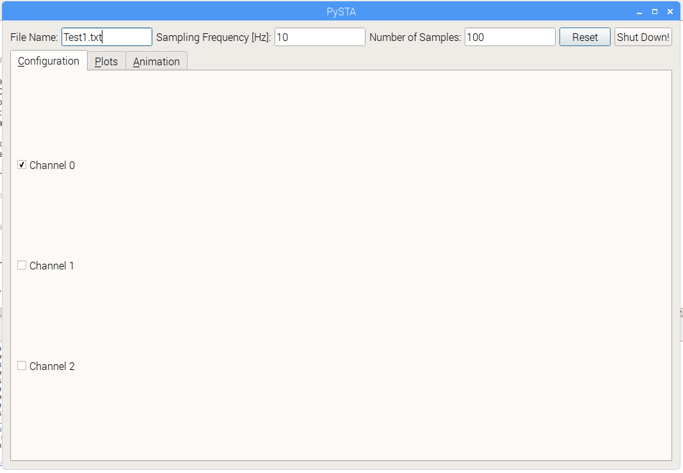
GUI: Initialization Pane

Slide 11
GUI: Configuration tab

Slide 12
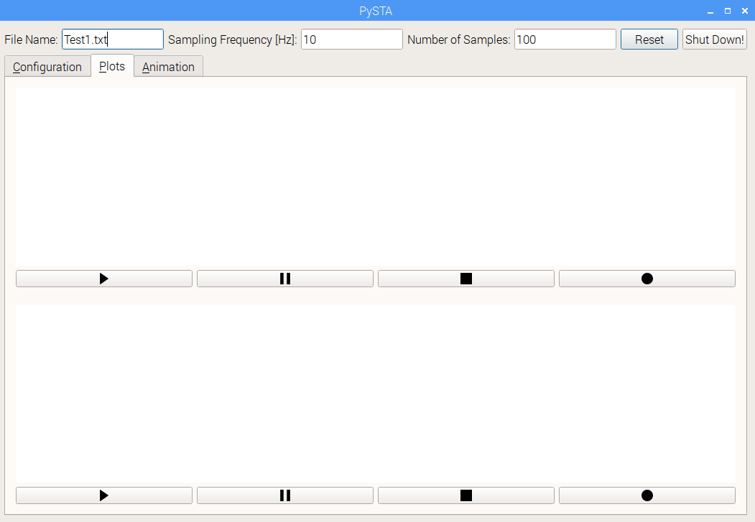
GUI: Plots tab

Slide 13
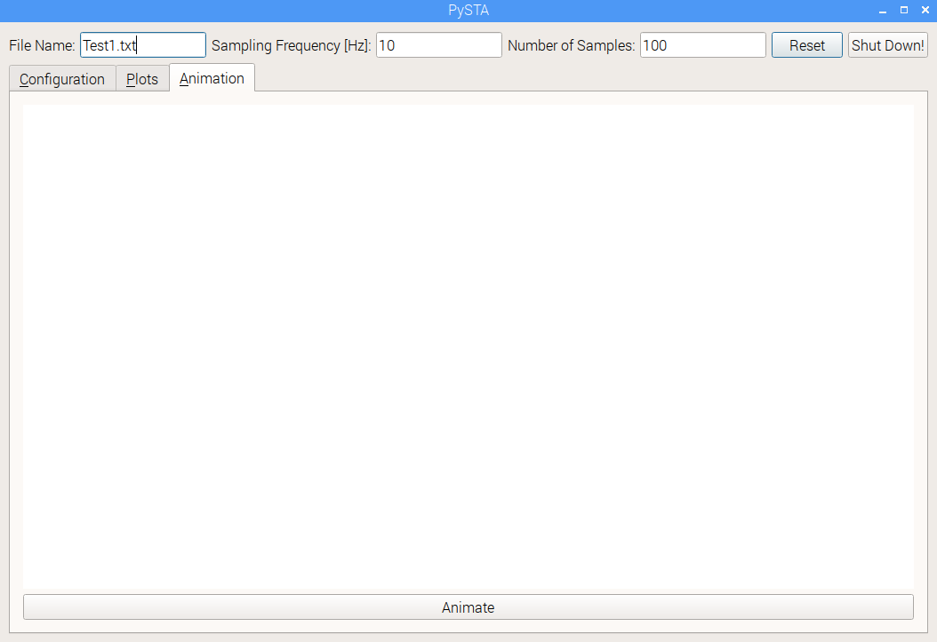
GUI: Animation tab

Slide 14
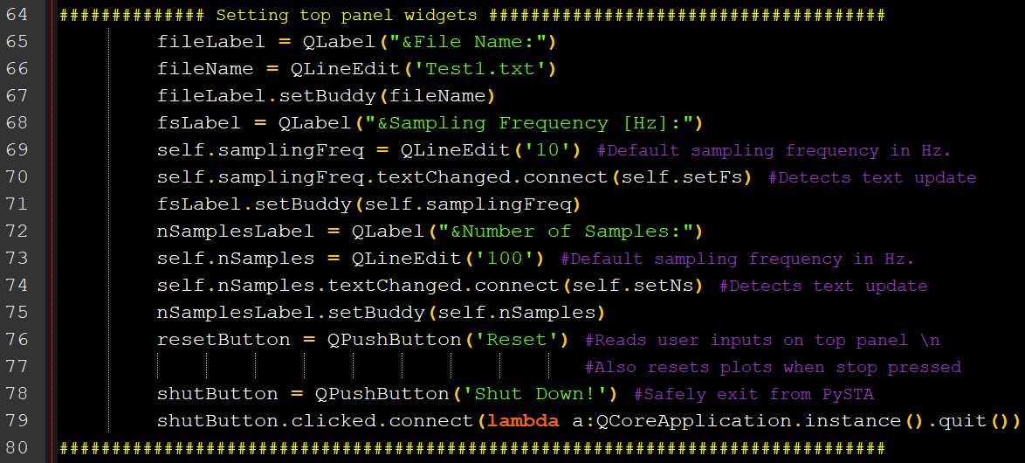
Code Development: GUI
Initialization Panel

Slide 15
Code Development: GUI
Initialization Panel

Slide 16
Code Development: GUI
Initialization Panel

Slide 17
Code Development: GUI
Initialization Panel

Slide 18
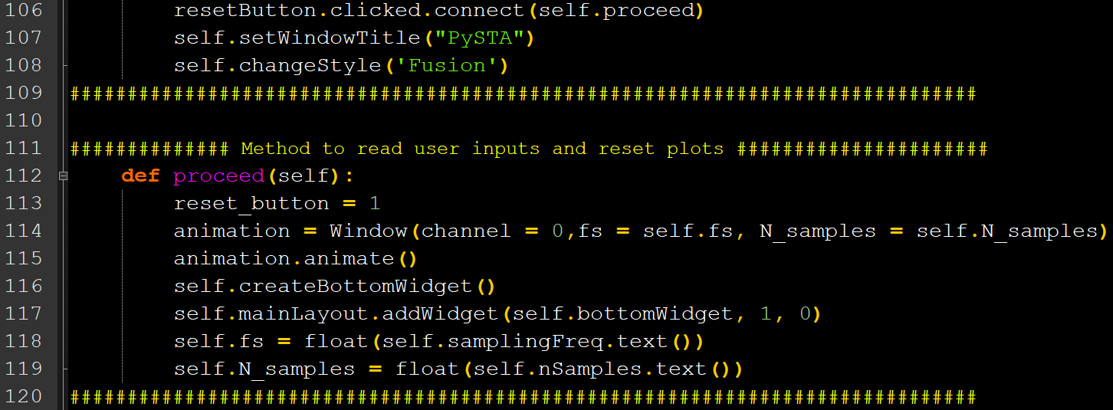
Code Development: GUI
Initialization Panel

Slide 19
Code Development: GUI

Slide 20
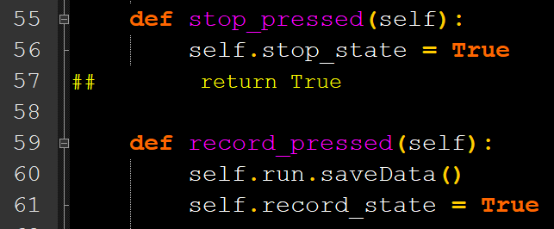
Code Development: GUI
plot_in_gui.py

Slide 21
GUI: Animation tab

Slide 22
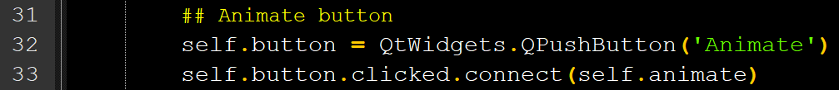
Code Development: GUI
beam_animate_in_gui.py

Slide 23
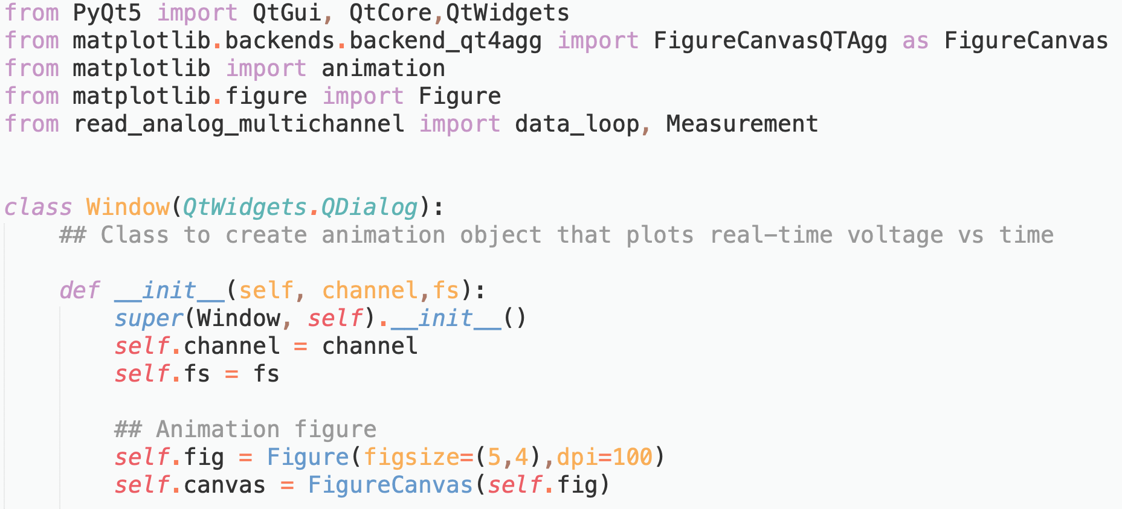
Code Development: Animation

Slide 24
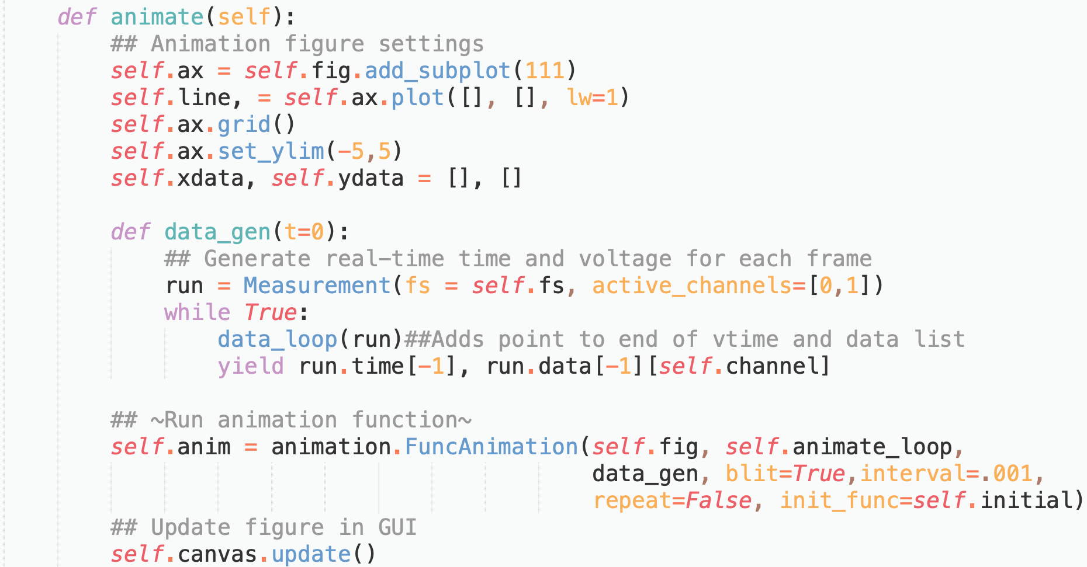
Code Development: Animation

Slide 25
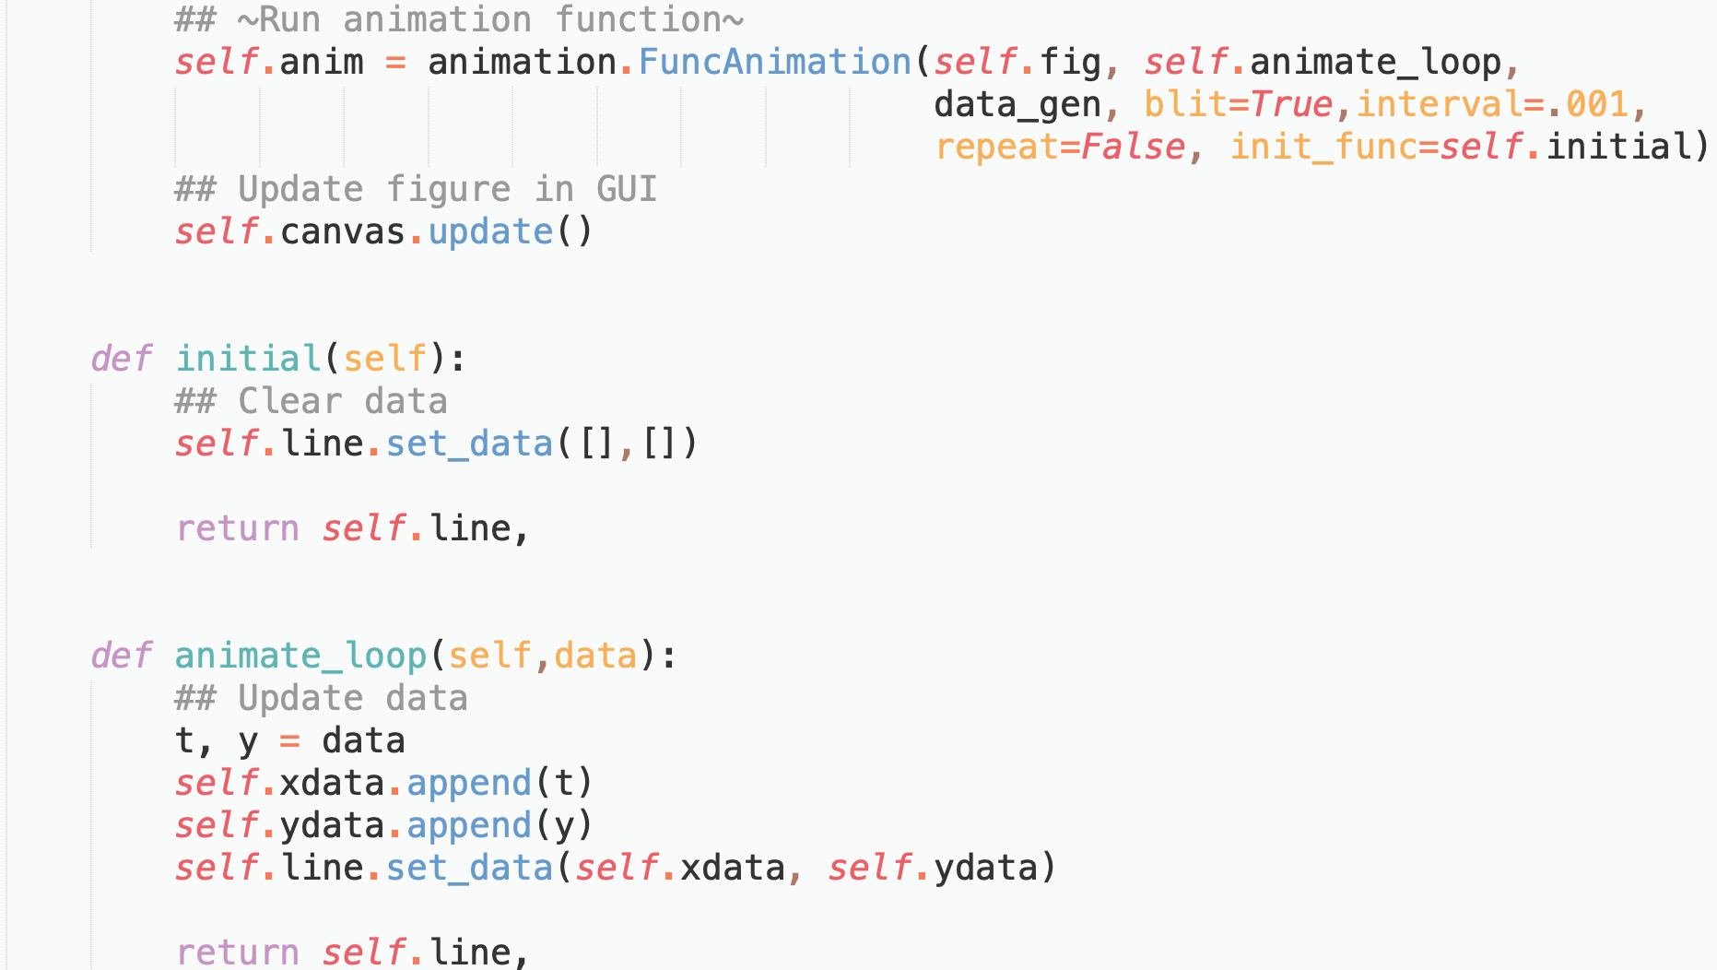
Code Development: Animation

Slide 26
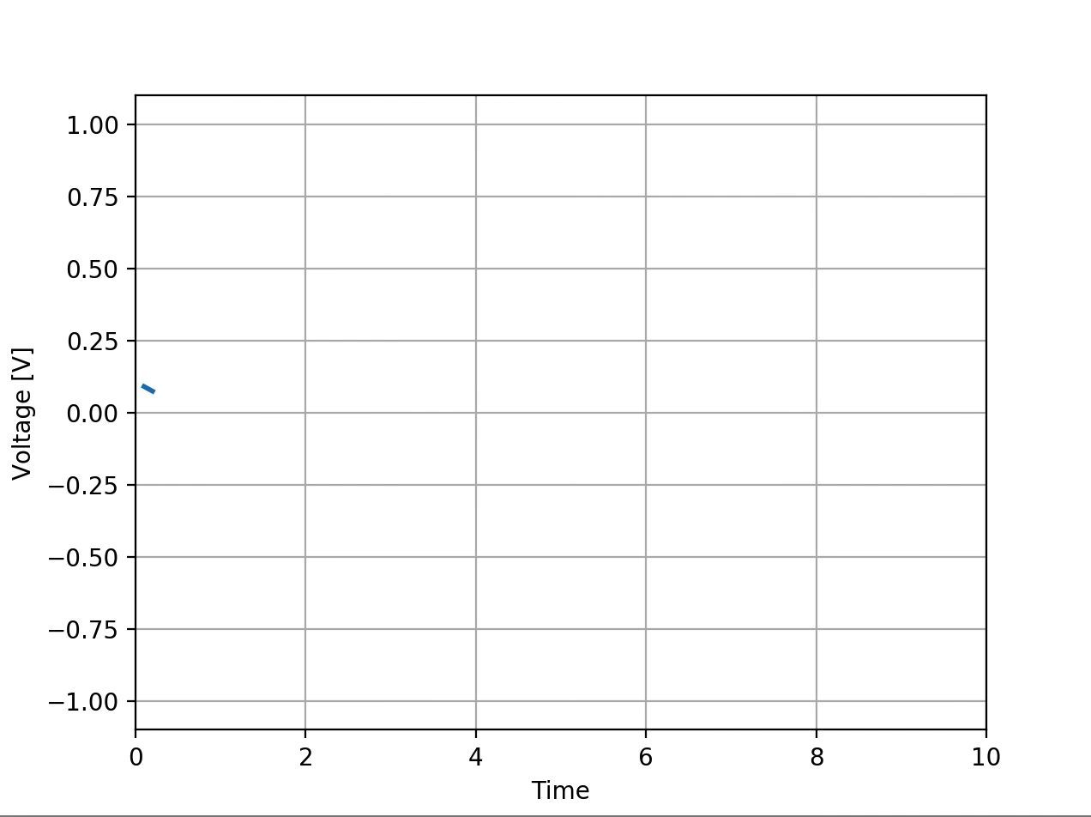
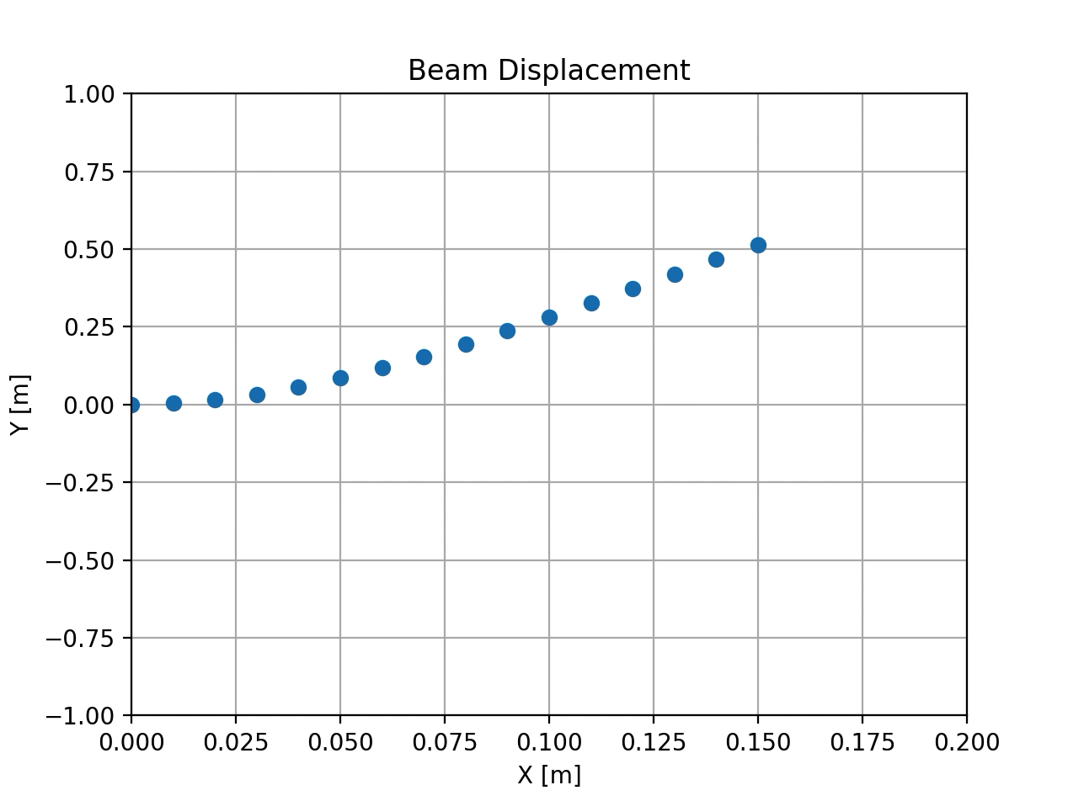
Code Development: Animation
Simulated Voltage Outputs:
Simulated Beam Displacement Animation:

Slide 27
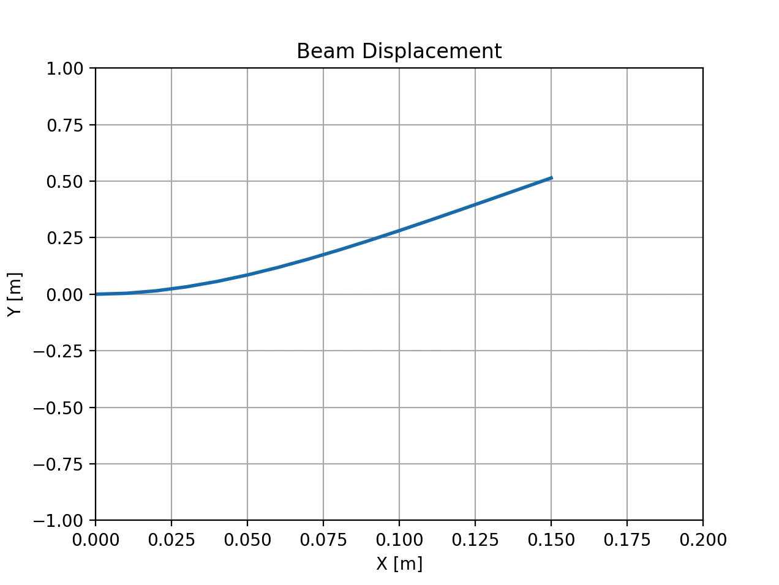
Code Development: Animation
Simulated Voltage Outputs:
Simulated Beam Displacement Animation:

Slide 28
Future Work
Saving data to file in the GUI
Interfacing setup with hydraulic servos

Slide 29
Questions or Comments?

